Slide 1
Cinema Booking System
CSYE 6200 – Object Oriented Design
Professor: Jones Yu
Team name: The Movie Buffs
Team members:
Amulya Murahari
Karthik Malasani
Chinmay Dharwad

Slide 2
Contents
Introduction | An introduction to CINEMA BOOKING SYSTEM
Techstack used | A brief explanation about the tools used for the project
Workflow | The events managed by each user i.e Admin and Customer
Admin | A detailed explanation about the Admin pages and workflow
Customer | A detailed explanation about the Admin pages and workflow
Java features used | The various features of Java that have been implemented in the project

Slide 3
Introduction
Welcome to the Cinema Booking System project presentation. In this project, we have developed a comprehensive cinema booking system using Java and JavaFX. This system aims to provide an efficient and user-friendly platform for customers to browse and book movie tickets, and for administrators to manage movie listings and bookings. Whether you're a movie enthusiast or an admin responsible for smooth operations, this project has to offer the best of both sides.

Slide 4
Key features
Key Features:
User Authentication: Secure login systems for customers and administrators.
User Profiles: Customers and admins can edit their personal information.
Movie Selection: Customers can view available movies and their details.
Booking Management: Customers can choose movies, dates, times, and seats for booking.
Admin Control: Admins can manage movie listings, create new movies, and manage bookings.
Feedback: Customers can provide valuable feedback on their experience.

Slide 5
Techstack
Java
Java FX
Fxml
Tools used:
Eclipse,
Scene Builder

Slide 6
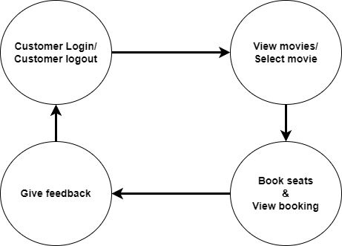
Customer workflow

Slide 7
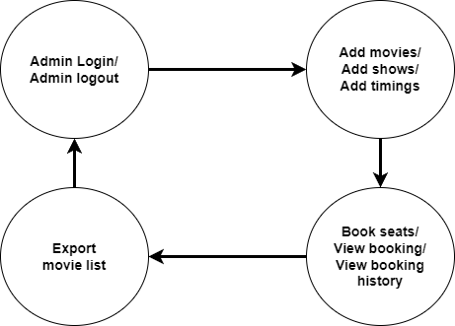
Admin workflow

Slide 8
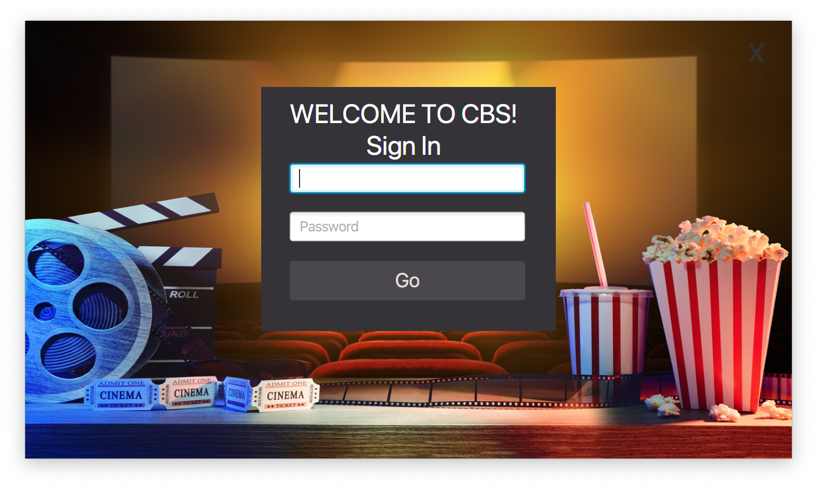
Login Page
This is the Login Page of our Cinema Booking System.
It takes in the Username and Password of the customer to log into the system
If the username and password does not match, an error is seen.

Slide 9
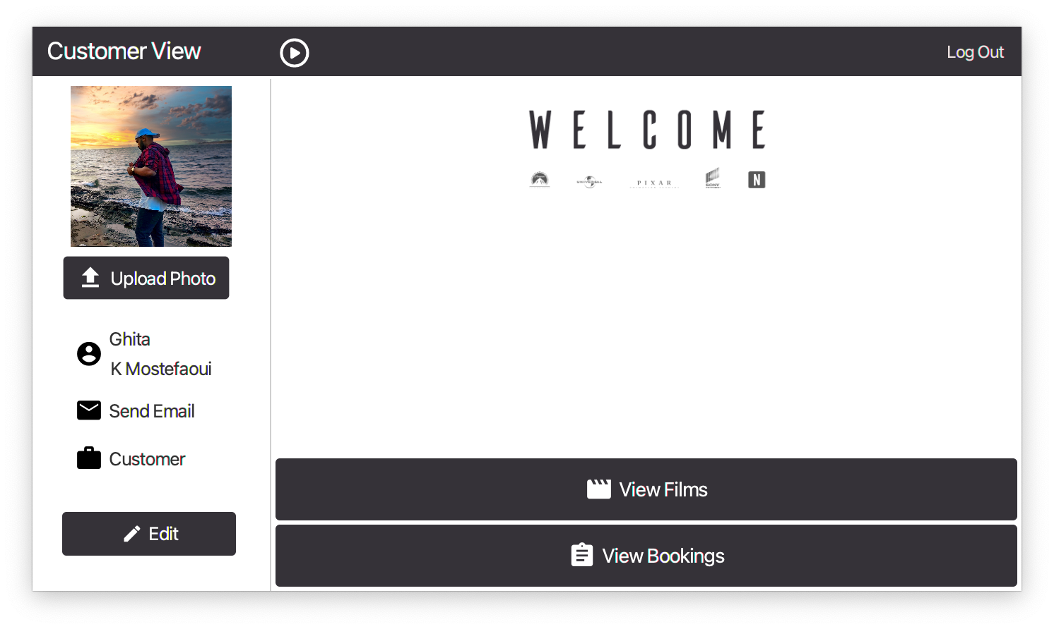
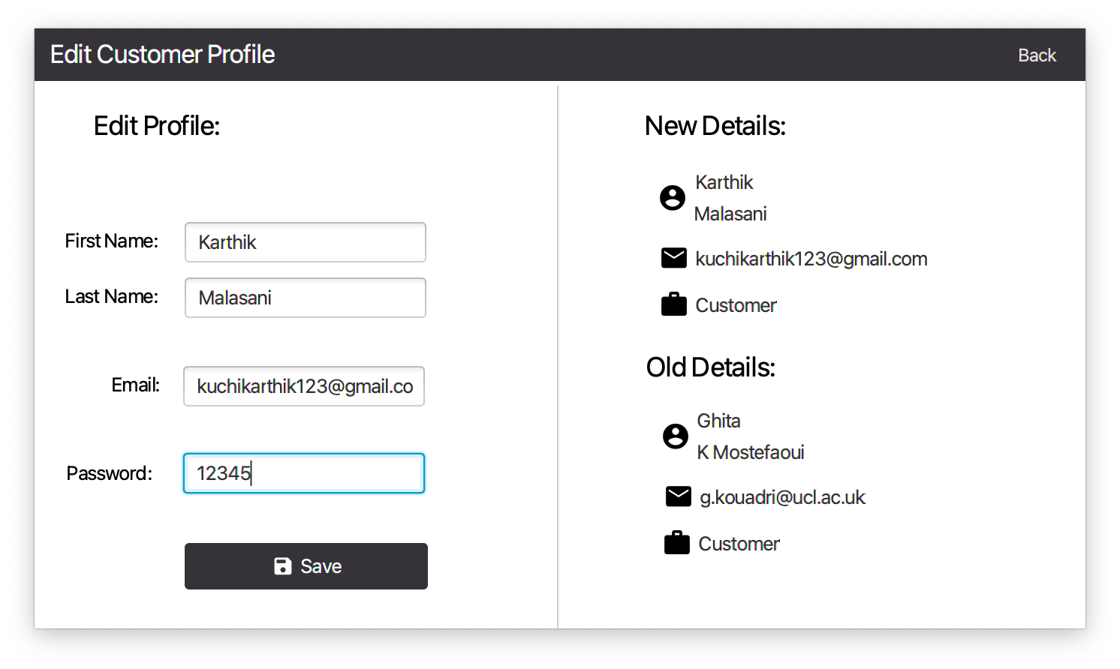
The customer can upload his/her profile photo and edit personal details on their welcome page.
The customer can also view the old details and the new details that has been entered
They can also View Films and View Bookings of the cinemas.

Slide 10
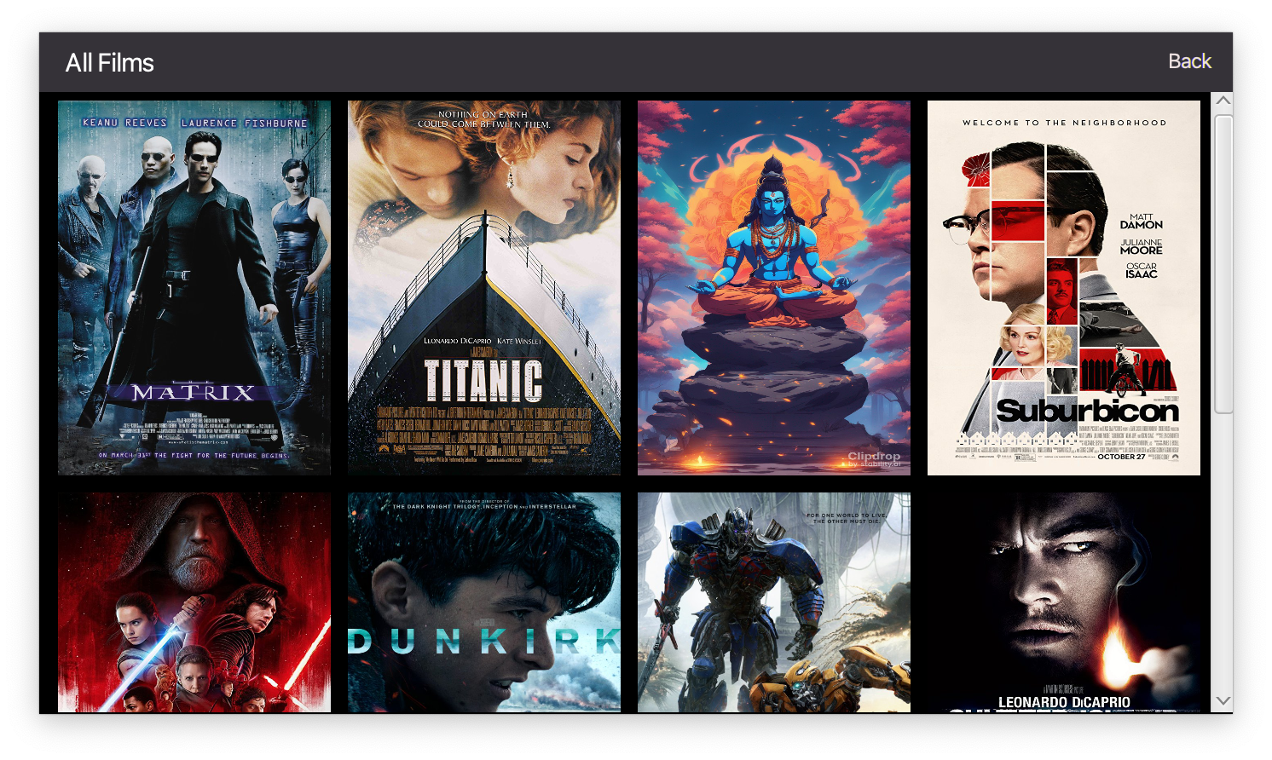
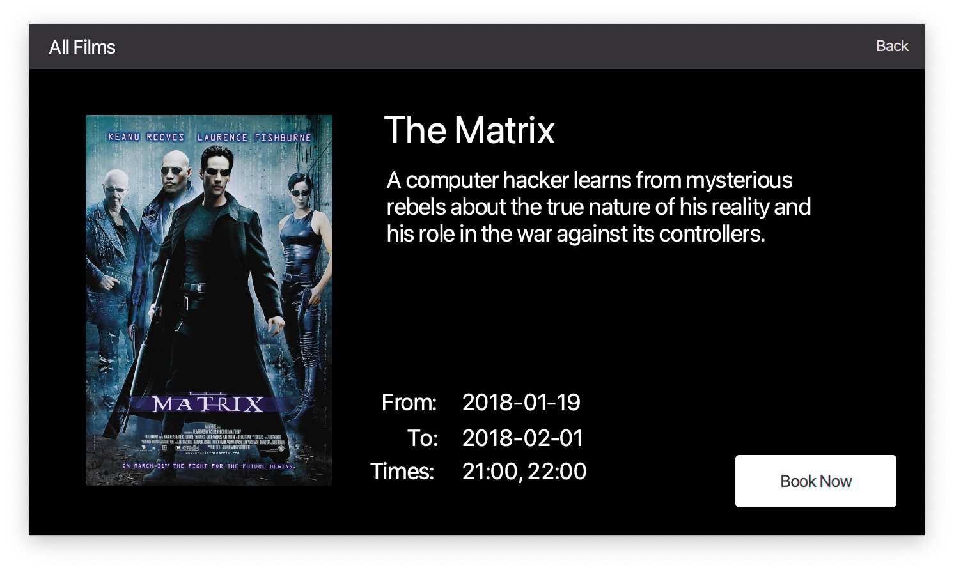
The View films page gives access to all the movies that are available to book in the cinema theatre. The customer can click on any movie and get details about it. The ‘Book Now’ button leads to the cinema booking page

Slide 11
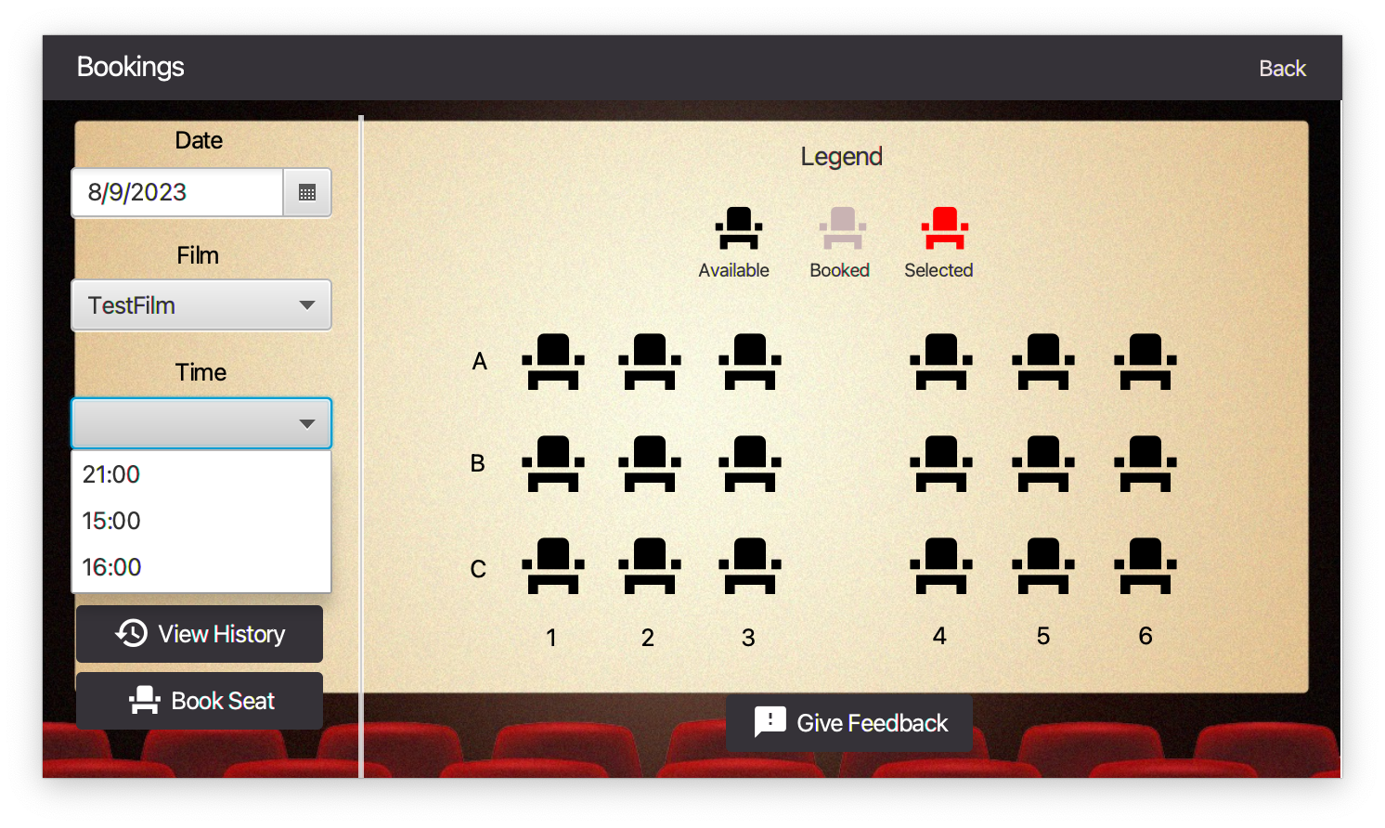
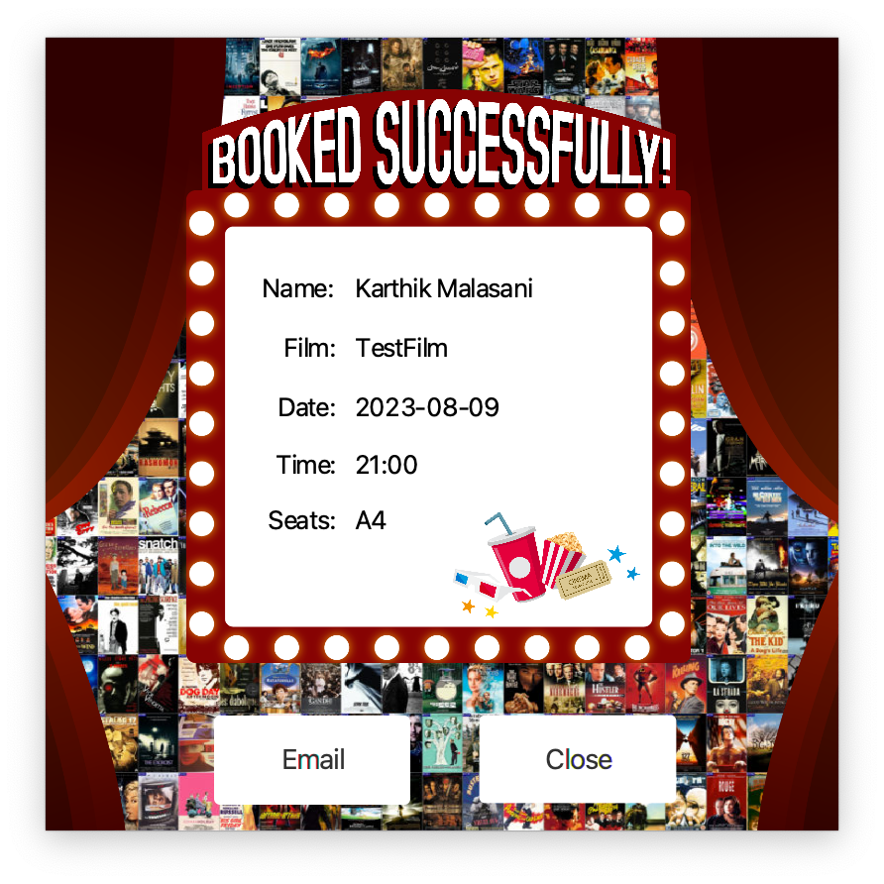
This is the bookings page, where the customer can select the seats, date, time and the film to be booked. The customer can also view the View History and Give Feedback on the experience.
Once the movie has been booked successfully, a pop-up Ticket is displayed on the screen
It shows the Name, Film, Date, Time and Seat allocated number.

Slide 12
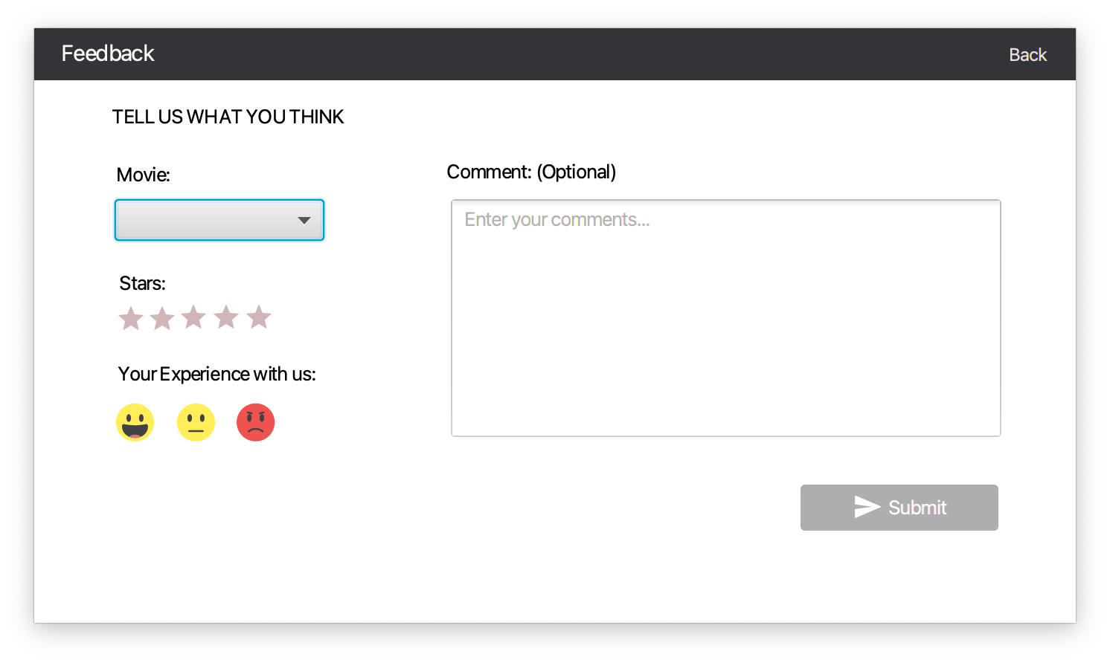
This is the feedback page where the customer can leave comments about the movie and even give a rating by choosing the specific movie.

Slide 13
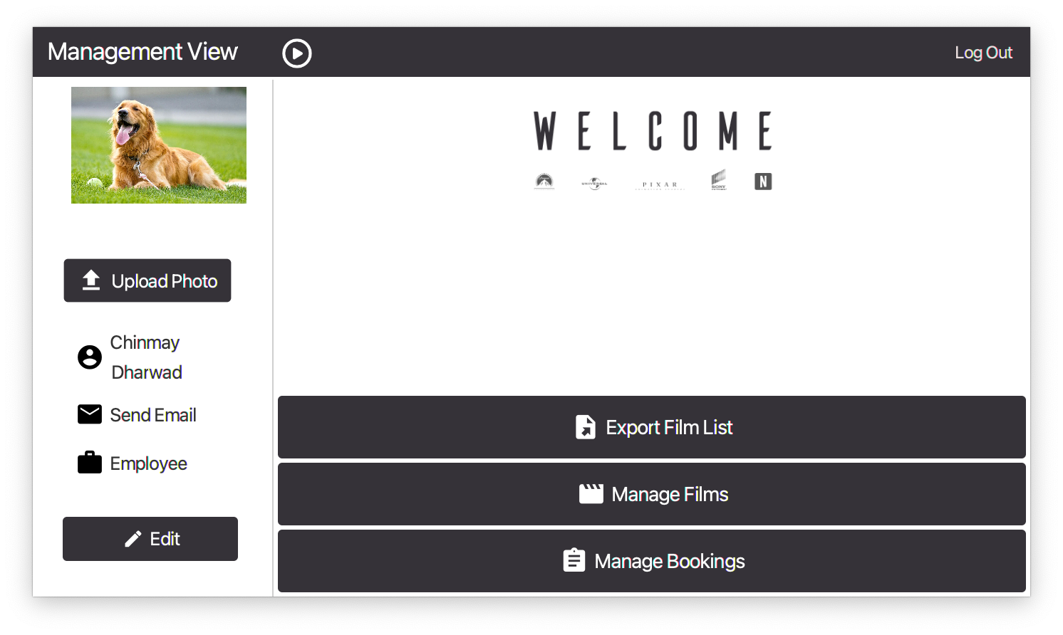
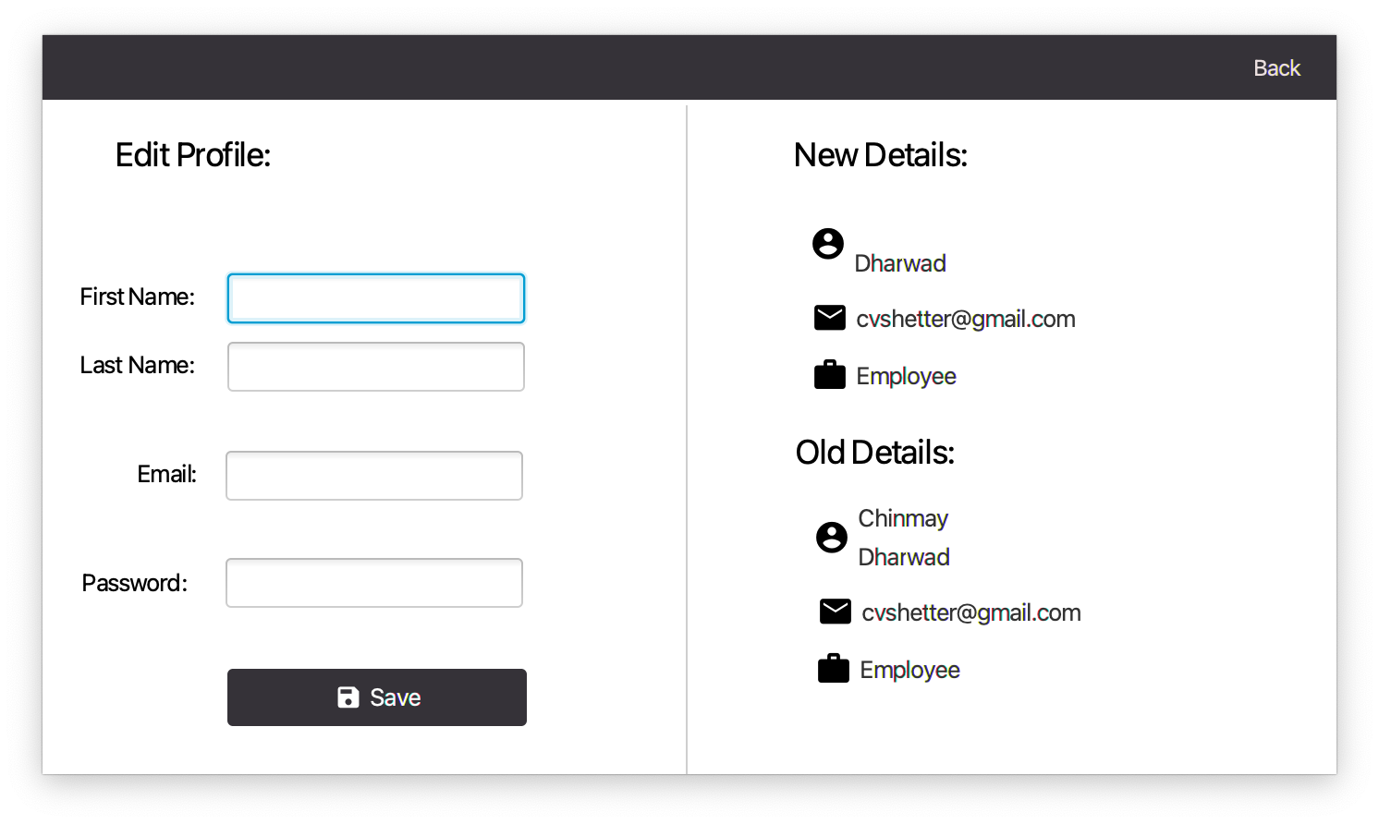
This is the admin view page, which lets the admin edit his/her personal details.
The admin has access to export the film list, manage films by adding or deleting a particular movie and manage bookings.
The admin can view old details and new edited details.

Slide 14
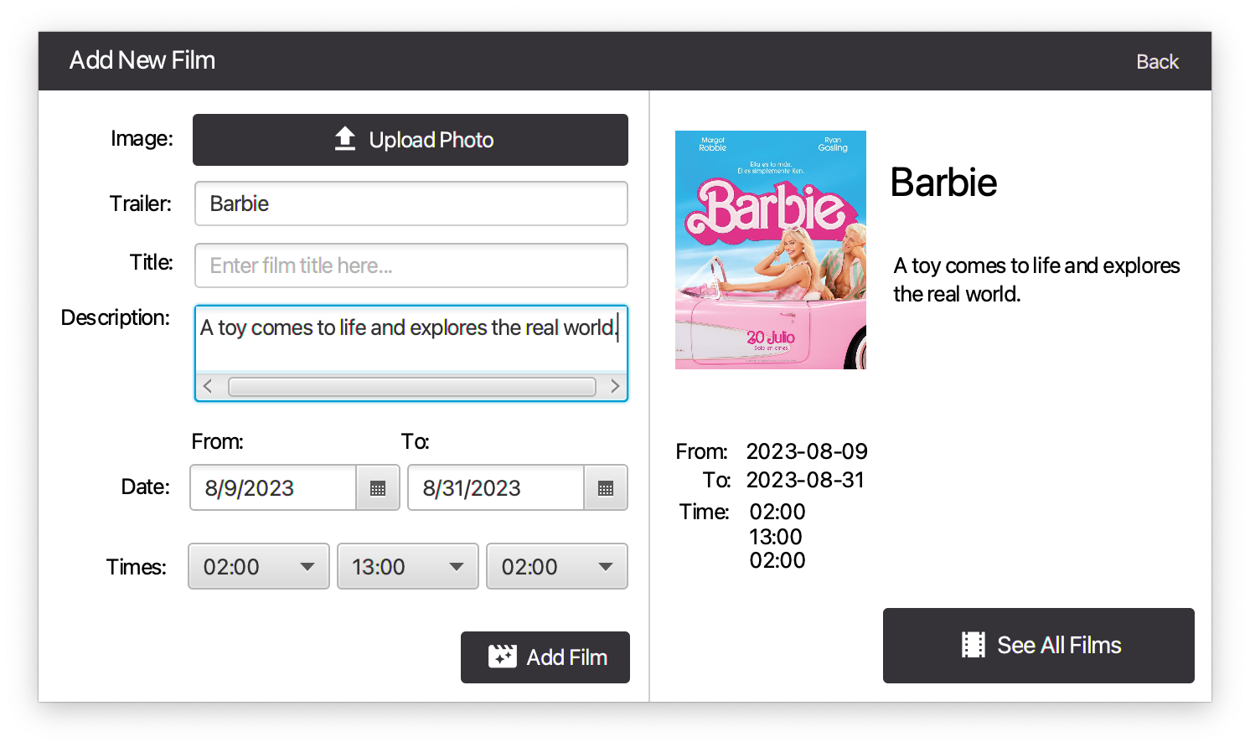
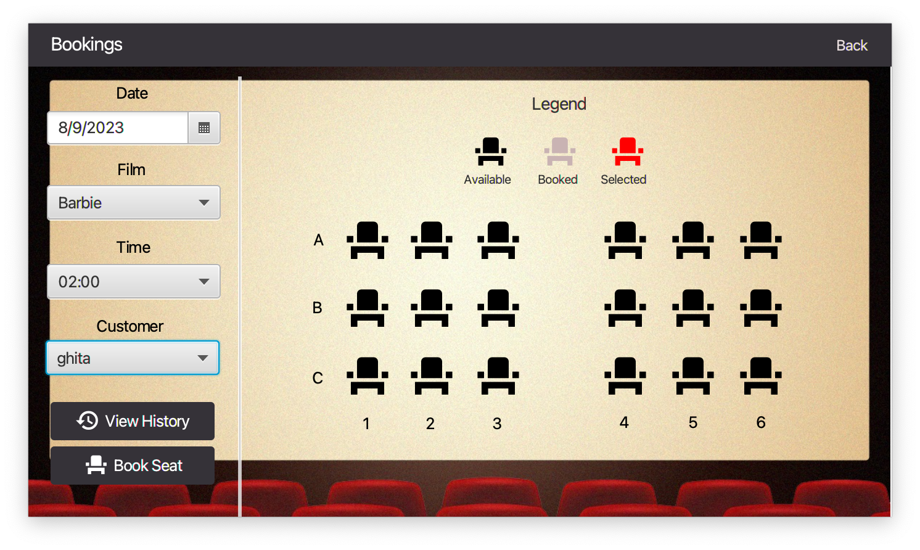
This page gives the admin options to add a new film into the database.
The admin can enter the title, image, description, date and timings of the new movie to be added.
The admin can then view the date, film, time and customer who has booked the movie.

Slide 15
Java features
Enter the 5 features we implemented here:
1) Defined 19 Classes 2) Inheritance of Customer, Employee from User class 3) Used Intilizable JavaFX interface to work with the generated FXML files 4) Used ArrayList of booking history data, Users, Films getting the data from JSON file 5) Used generics to handle types of movies like regular, 3D or live

Slide 16
Thank You!
CSYE 6200 – Object Oriented Programming

